Slide 2
Automating Detection & Response Outcomes using Cisco XDR
.. and how CX Automation can help!
Aman Sardana, Scott Dozier
Engineering Architects, Cisco CX Services & Product Portfolio @amsardana, @ScottDozier_
BRKATO-1557
Notes:
Hello, let me welcome you to today’s session on automating detection and response outcomes using Cisco XDR.
In an era where organizations are facing an ever-growing challenge of protecting assets from increasingly sophisticated cyber threats, traditional security approaches without XDR will not be able to keep up.
Today we are excited to introduce you to Cisco XDR, and specifically its built-in automation and orchestration platform, XDR Automate, that has the ability to power all of your response workflows you will need for your organization.
Allow me to introduce myself, Scott Dozier, and my colleague , Aman Sardana. We are both engineering architects in the Cisco CX Services and Product Portfolio. We are excited to teach you how to use XDR Automate so that you can leave the session with all the knowledge to get started building your very own workflows.

Slide 3

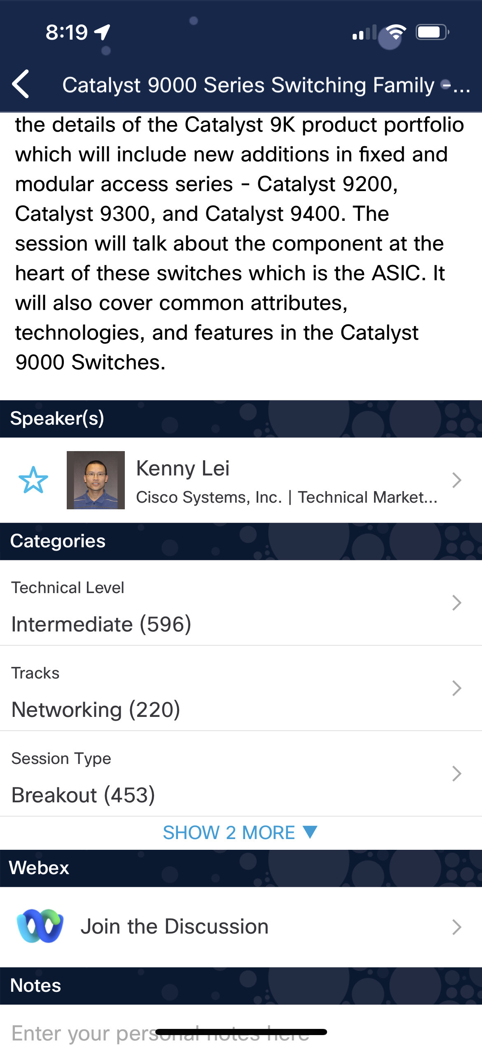
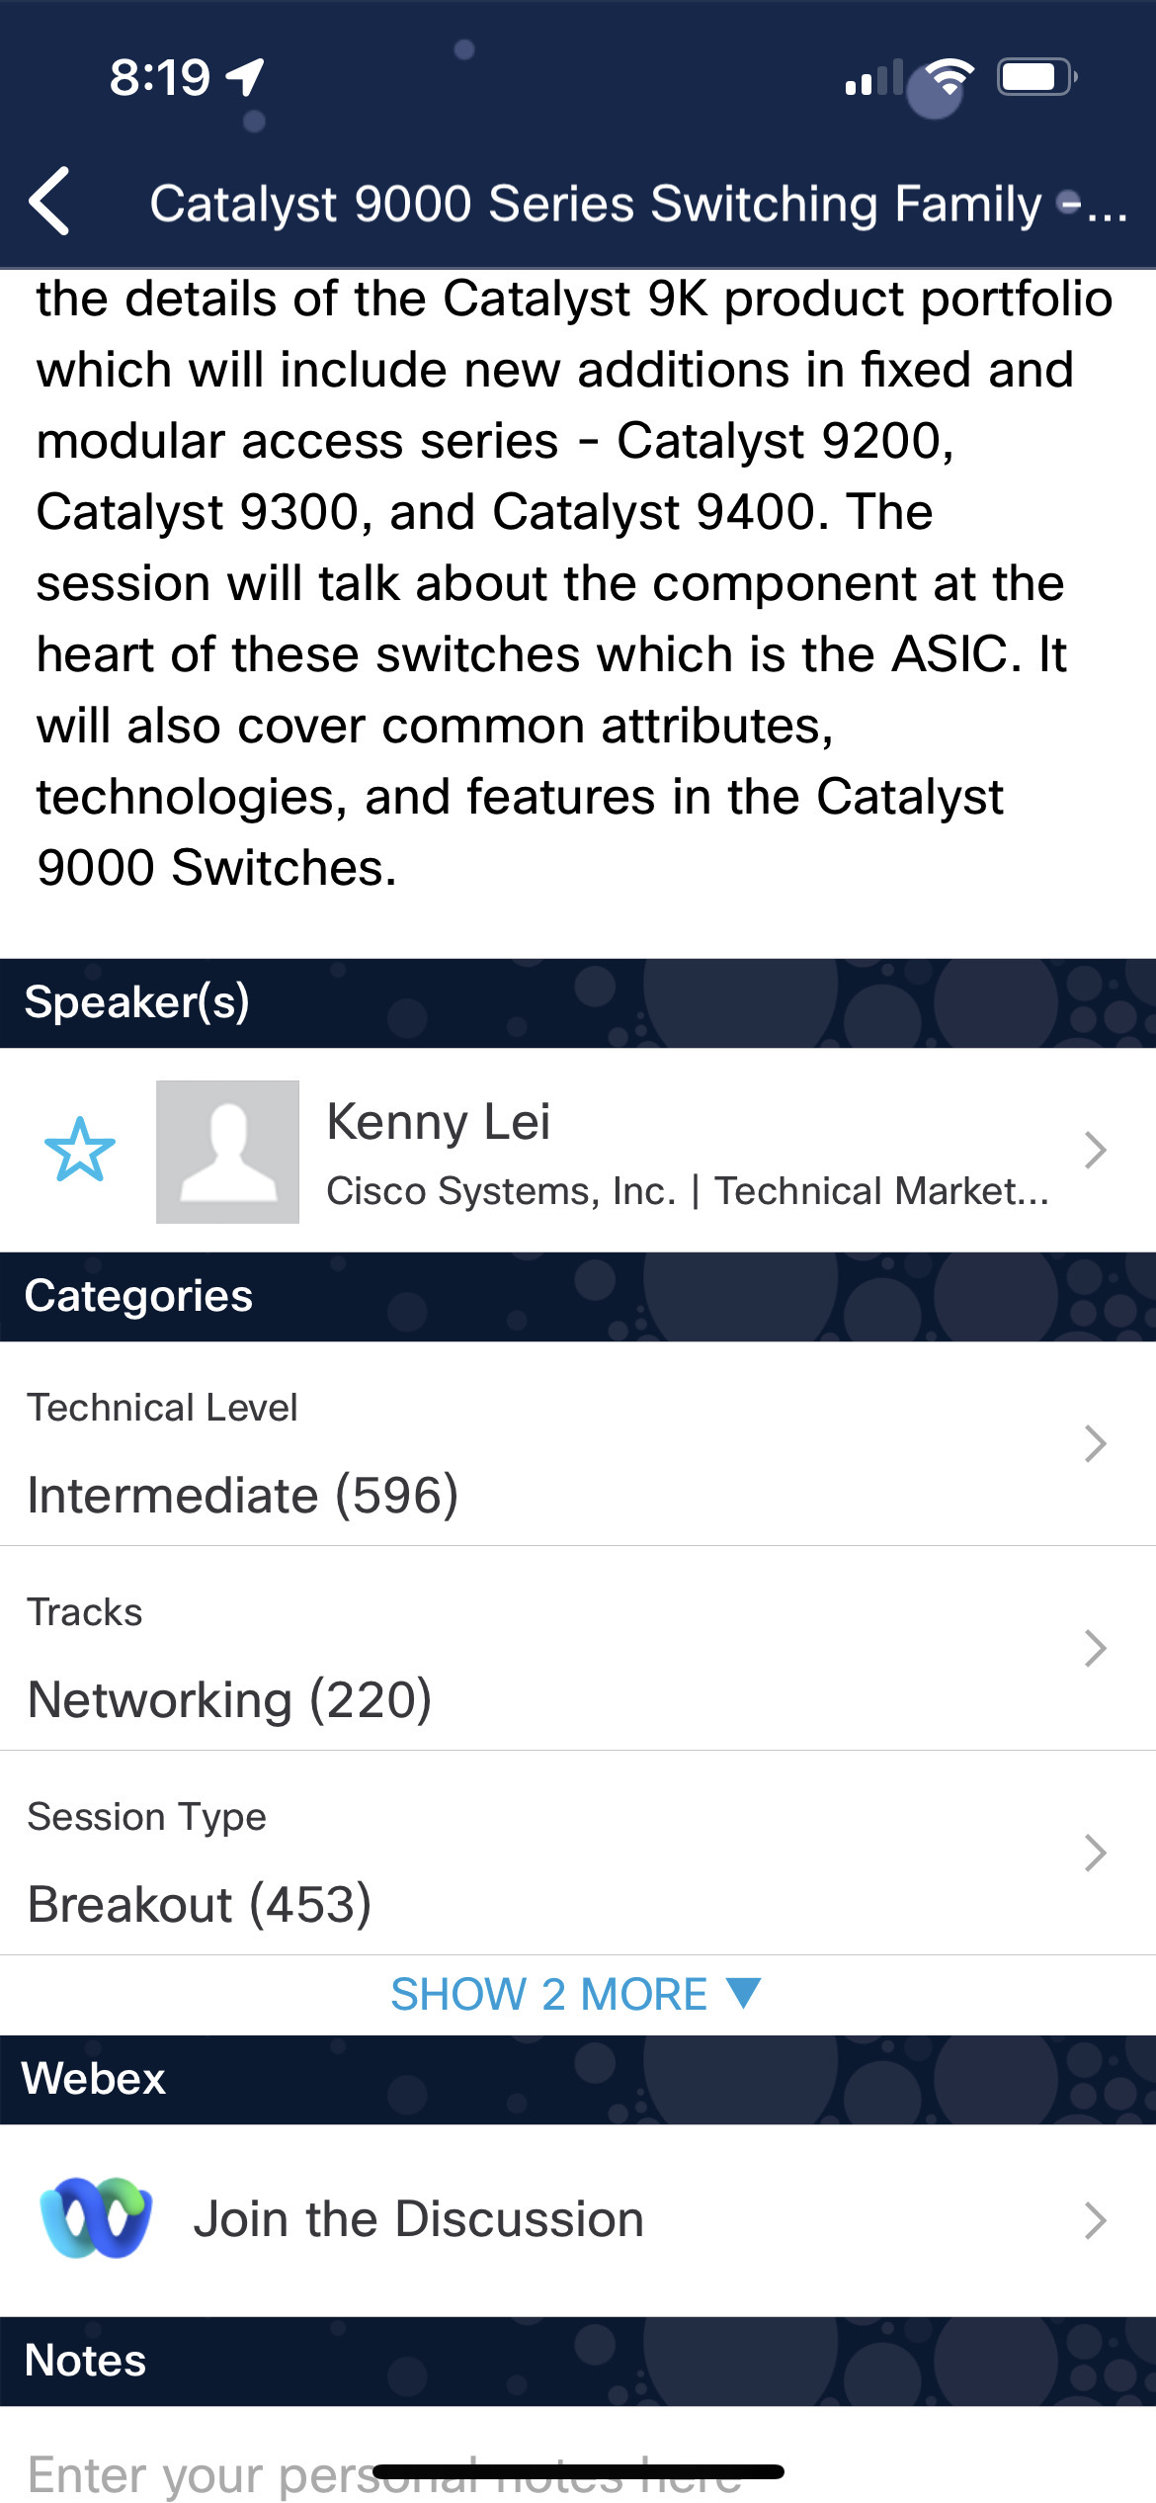

Cisco Webex App
Questions? Use Cisco Webex App to chat with the speaker after the session
How
1
Find this session in the Cisco Live Mobile App
Click “Join the Discussion”
Install the Webex App or go directly to the Webex space
Enter messages/questions in the Webex space
2
3
Enter your personal notes here
4
Webex spaces will be moderated by the speaker until June 9, 2023.
https://ciscolive.ciscoevents.com/ciscolivebot/#BRKATO-1557
© 2023 Cisco and/or its affiliates. All rights reserved. Cisco Public
3
Notes:
Before we get started, let me make sure that you are aware that we have a Webex discussion where you can ask questions after the session. You can find the session in the Cisco Live! Mobile App, under this session, and clicking the “Join the discussion.” link
Aman and I have a passion for architecting automation solutions within CX, but not security experts. So this space will also allow us to bring in security experts as needed for questions we don’t immediately have an answer.
In fact, Aman and I are just a couple of collaboration CCIEs trying to give a breakout session about a security product, which makes total sense right? Its really just that we find the XDR automate platform so exciting and easy to work with that we decided to do this breakout even though it’s not our day-to-day.
So if we can pick up this platform so easily, we know you can too!

Slide 4
Safe Harbor Statement
This presentation contains projections and other forward-looking statements regarding future events or the future financial performance of Cisco, including future operating results.
These projections and statements are only predictions. Actual events or results may differ materially from those in the projections or other forward-looking statements.
Notes:
Today we will describe and perform a demo of Cisco XDR, a product that is not yet generally available. We really wanted to go ahead and get you learning about this exciting product, but please know that pieces of the product may change before it is available to the public. Any forward-looking statements about Cisco XDR that are made by us are with the information available today and may change in the future.

Slide 5
Introduction to Cisco XDR
Automating with XDR Automate Do it yourself.
Command & Control Use Case + Demo! We’ll show you how to.
Cisco Secure Managed Detection & Response We’ll do it for you.
Conclusion
Notes:
Taking a look at today’s agenda, we are going to briefly introduce to you Cisco’s XDR solution which was just recently announced at the RSA Conference 2023. Next, We will dive right into learning how to automate with XDR Automate and show you how easy it is to build workflows in just a few minutes.
We will continue with a command and control use case demo, where we will be building and executing a workflow live on the Cisco XDR platform.
After the demo, we want to tell you a little about our Cisco MDR offer and how it can be a benefit to your organization
Finally, we will finish with some conclusions, callouts, and a quick Q&A

Slide 6
Introduction to Cisco XDR
Notes:
Now lets us quickly get into Cisco’s Extended Detection and Response solution

Slide 7
In a hybrid, multi-vendor, multi-vector universe
Everyone is an insider
Attacks start from anywhere
Alert fatigue is real
Expanding attack surface
+30%
of all incidents involved stolen credentials or malicious insiders
45%
of breaches occurred in the cloud, and 19% due to a compromise at a business partner 37%
of IT and SecOps pros say swelling alert volume, and complexity increases job difficulty increases j22%
increase in the the average cost of a data breach where hybrid work was a factor
Source: IBM Security and Ponemon Institute 2022 Cost of a Data Breach Study
Notes:
So why does the world need another security approach? The reason is that security operations teams are facing an increasingly growly and changing landscape. Attacks start from anywhere. 45% of the breaches last year occurred in the cloud and 19% occurred due to a compromised business partner. Additionally, hybrid work expands the attack surface even further and drove the average cost of a breach up by 22% in 2022. All of this is occurring at the same time when security personnel are understaffed and just overwhelmed by the swelling alert volume.

Slide 8



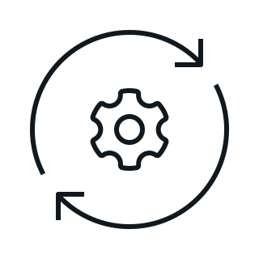
What is Cisco Extended Detection & Response?
A means to detect more, act faster, elevate productivity, build resilience
Detect the most sophisticated threats
Act on what truly matters, faster
Elevate productivity
Build resilience
Multi-vector detection: network, cloud, endpoint, email, and more
Enriched incidents with asset insights, threat intel
Optimized for multi-vendor environments
Prioritize threats by greatest material risk
Unified context to streamline investigations
Evidence-backed recommendations
Focus on what matters and filter out the noise
Boost limited resources for maximum value
Automate tasks and focus on, strategic tasks
Close security gaps
Anticipate what’s next through actionable intel
Get stronger, everyday with continuous, quantifiable improvement
Learn more about Cisco XDR at Cisco Live: BRKSEC-2113 (June 7), BRKSEC-3116 (June 8)
Notes:
XDR is the answer to addressing the problems we just talked about. In fact, in 2022, organizations that employed XDR responded 29 days faster than those that didn’t.
So what is Cisco XDR or Cisco’s version of extended detection and response? Cisco Extended Detection & Response is essentially a successor to endpoint detection and response. While EDR was very successful solution in the 2010s, it is no longer enough to detect more sophisticated threats. XDR extends EDR to encompass and correlate data from multiple vectors including the network, cloud, email, threat intelligence, and even through 3rd party integrations such as Crowdstrike Falcon or Microsoft Sentinel. Think about how attacks today can start with an email, luring a user to click a link, which downloads malware, which then spreads across the network.
Moreover, XDR allows security teams to elevate their productivity by reducing noise and prioritizing threats with the greatest risk. Finally, Cisco XDR allows users to accelerate response times through built-in response actions or customizable orchestration workflows.

Slide 9

XDR Outcomes & Components
Detect Sooner
Prioritize by Impact
Reduce Investigation Time
Accelerate Response
Extend Asset Context
Integrations
Correlated Events
Investigation
Prebuilt
Playbooks
Integrations
Intelligence
Incident Manager
Account
and
Device Correlation
Machine Learning
Asset
Insights
Threat Hunting
Automated Workflows
Automated Enrichment
Notes:
So what is XDR going to give me?
The answer is faster detection by injecting machine learning and intelligence…. the ability to work on correlated, prioritized, and enriched events ... the reduction of investigation time .. and accelerating response through either prebuilt playbooks or customizable workflows which is the focus of our demo later in the session.

Slide 10
Powerful, flexible automation
Response
Automation rules
And more…
Analyst triggers a workflow from within the incident manager or a pivot menu
An incident matches a pre-defined rule and a workflow is triggered
Workflows triggered by users, APIs, webhooks, schedules, and more
Notes:
Cisco XDR brings powerful, flexible automation to your security teams. Analysts can trigger responses directly in the XDR interface or if automation is not suitable, they can utilize guided recommendations to take effective responses manually. Additionally, XDR Automate can trigger workflows from pre-defined rules, webhooks, and schedules, or via a comprehensive API.

Slide 11
Automating with XDR Automate Author security response workflows at lightning speed.
Notes:
Now let’s go into the details of XDR Automate

Slide 12


What is XDR Automate?
Simplify & streamline common IT tasks
Create security workflows
Centralize technologies
Create no-to-low-code workflows for commons tasks across all IT domains
Investigate security events and automate responses using pre-built atomics
Orchestrate actions across technologies and vendors to create a cohesive system
Notes:
So, what is XDR Automate? XDR Automate is a no-to-low code automation platform that allows users to build workflows for common or complex tasks across all IT domains. You can create automated security responses using pre-built atomics or orchestrate actions across technologies. XDR Automate is a security automation platform first, but what you can build there is really limitless. In fact, a version of the underlying XDR Automate technology is utilized by Cisco TAC to run thousands of different workflows for all kinds of use cases.
How many of you have opened a TAC case and interacted with Sherlock Holmes, the TAC engineer? Can you give me a show of hands? Yeah, you’ve been interacting with automation built with the same tech as XDR Automate, pretty cool right?

Slide 13
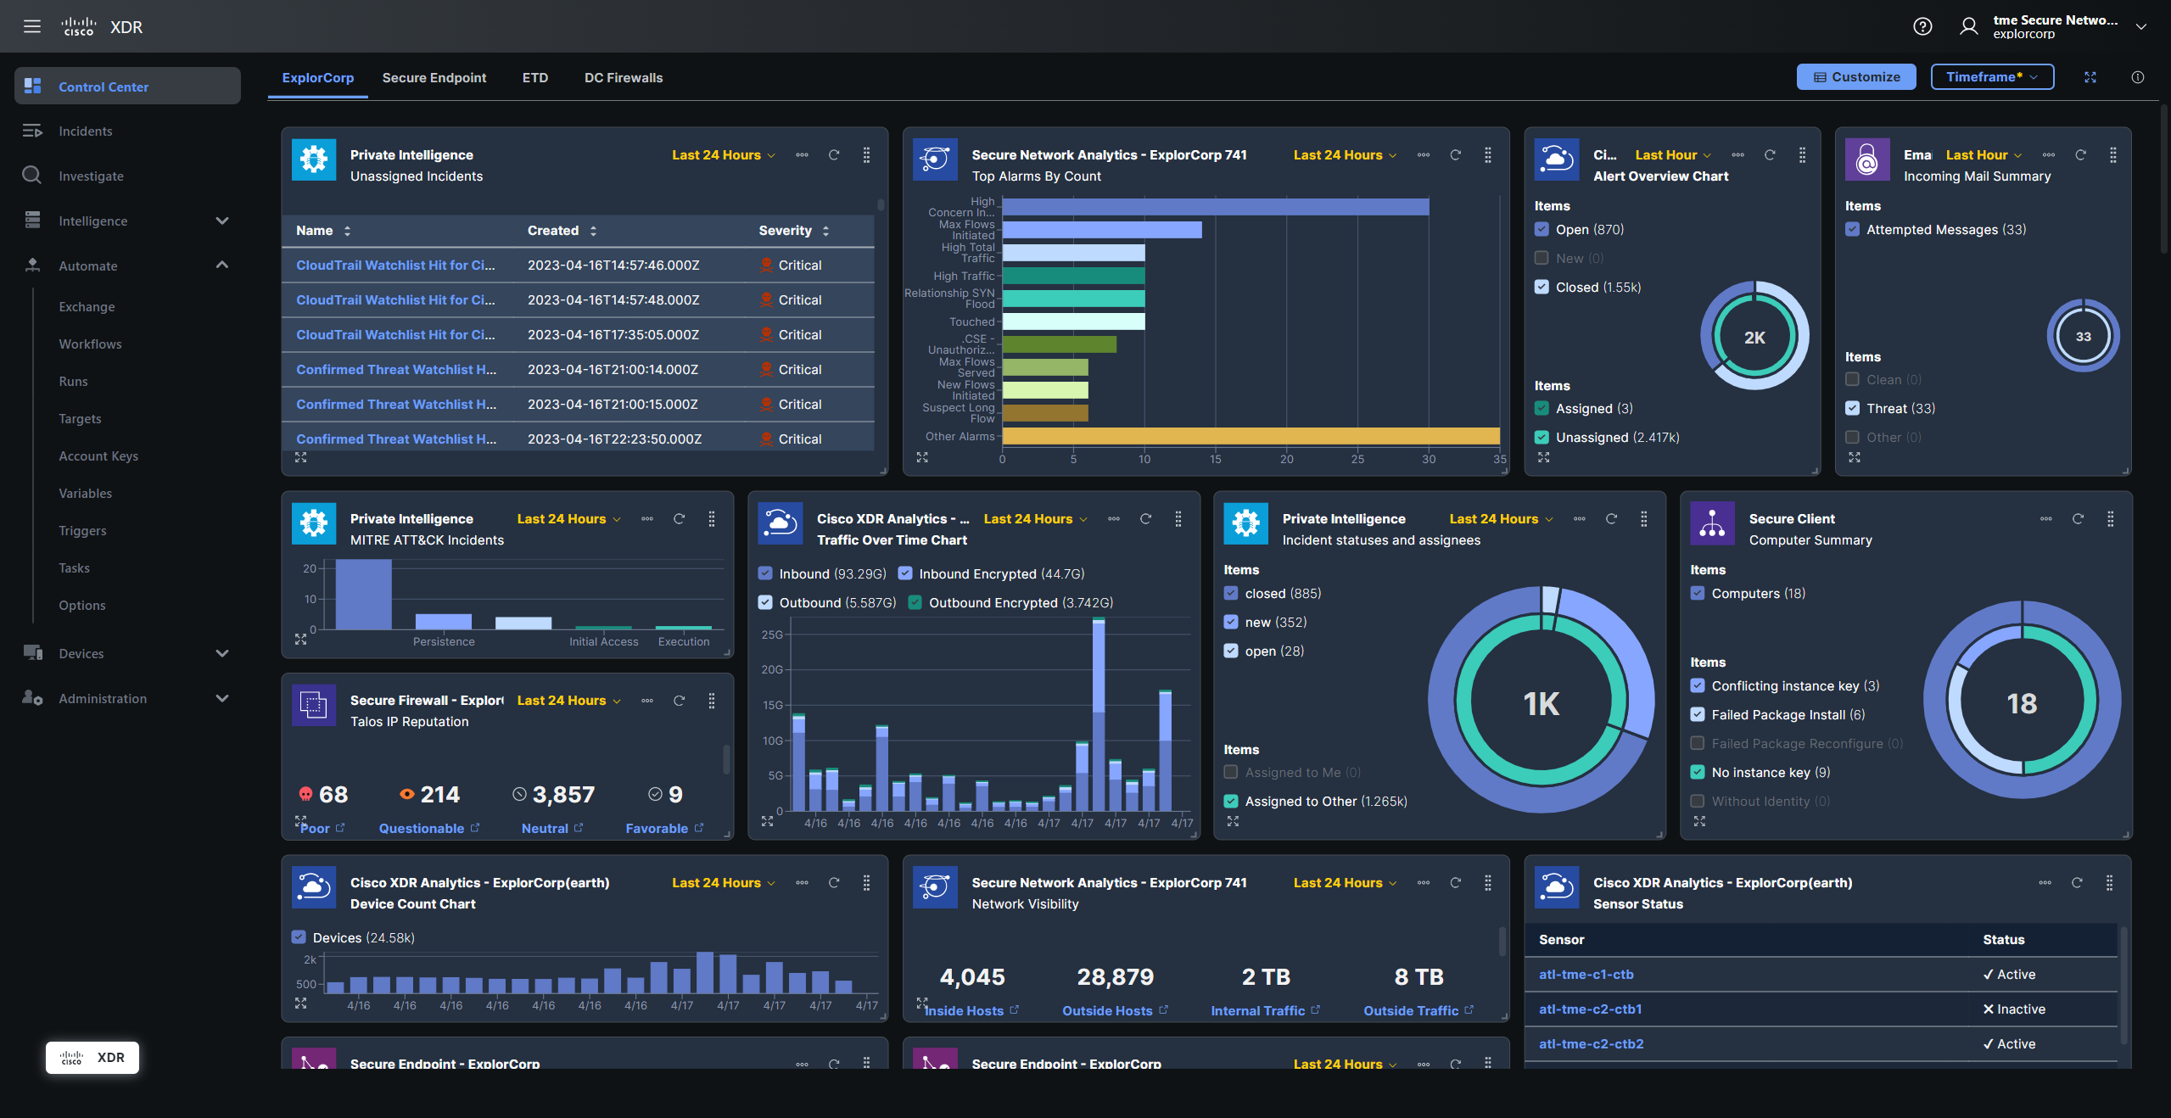

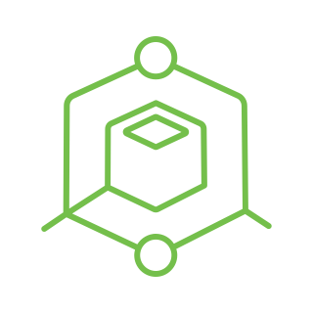
What is XDR Automate?
Included with XDR Essentials, Advantage & Premier
XDR Automate
No/Low Code
Extensible
Cloud Scale
Rich Library
Notes:
Now to finally give you a glimpse of the XDR interface which you will see very soon during the demo. This screenshot shows the entrypoint to XDR which is a customizable dashboard. XDR Automate can be seen from the left side, right in the middle of the menu tree. It’s worth noting that XDR Automate is available in all tiers of XDR, so if you get Cisco XDR of any type you will be able to create workflows like we discuss today.

Slide 14
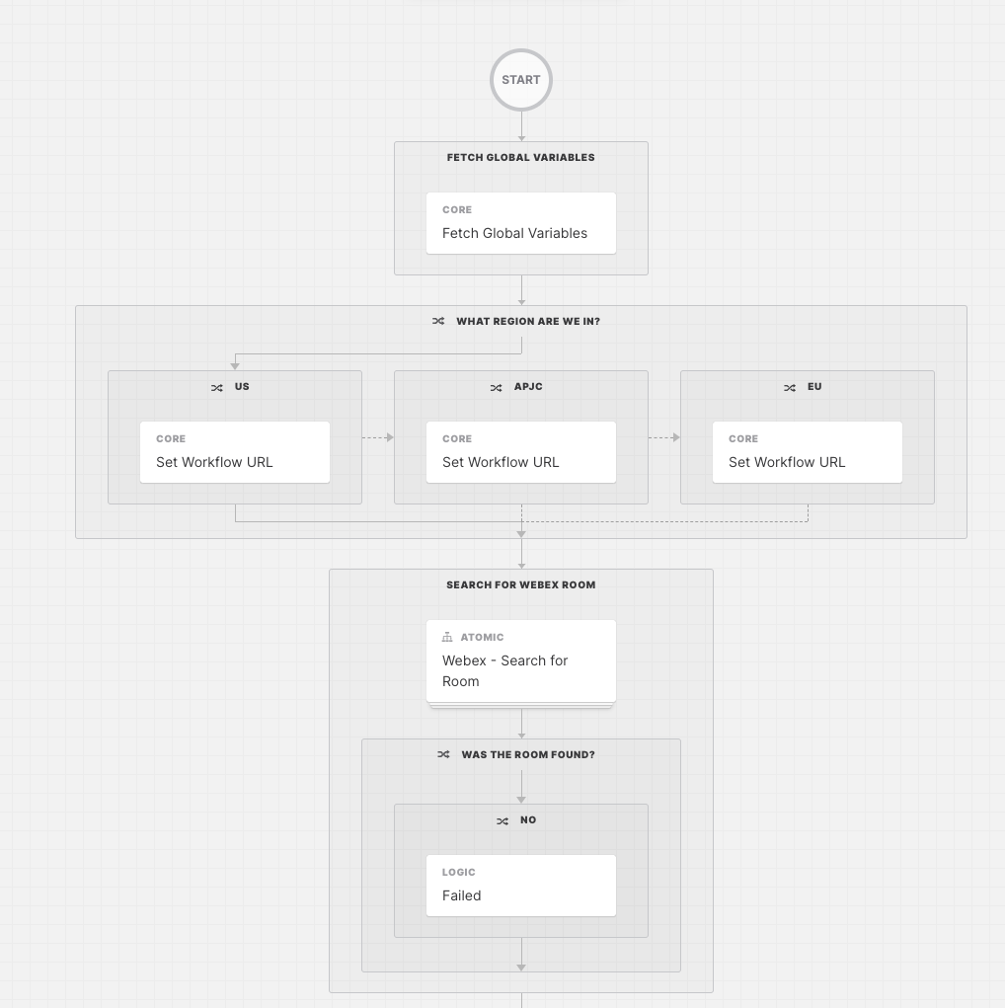
XDR Automate: Basic Concepts
Workflow - Sequence of activities
Activities - Actions such as HTTP requests, JSON parsing, or Python script execution
Targets - Endpoints to execute an action against
Variables - References to stored information that is passed between activities
Account Keys – Otherwise known as credentials and attached to targets
Triggers - Cause a workflow to execute based on an ‘automation rule’
Tasks – Allow human interaction (approvals)
Notes:
Now let’s start divining into the basic concepts which make up XDR Automate to get you ready for the demo. T
The list of items shown in blue are the key pieces of XDR Automate which will allow you to build and execute workflows.
Going down the list, the first concept is that of a workflow ,which is simply a sequence of activities. In XDR Automate you will build workflows visually in a drag-and-drop manner as shown in the screenshot.
Activities are the blocks to a workflow that perform an action such as an HTTP request, Jsonpath query, or python script execution.
Targets are the devices that are endpoints that the activities execute against. Targets can be assigned at the workflow or activity level.
Variables are references to stored information that are passed between activities.
Account keys store credentials and are assigned to targets.
Triggers define rules which will trigger a workflow to start.
And finally, tasks allow some external input to take place in order to continue, mostly used for approvals.
====
To infuse in the talk track, why is this so powerful? Why would u use XDR automate vs. some other solution? How is it more integrated to the XDR outcome? Why should audience invest time in learning to use it?

Slide 15
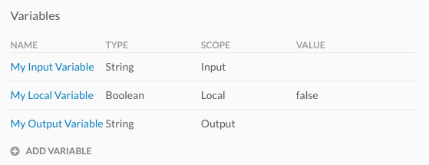
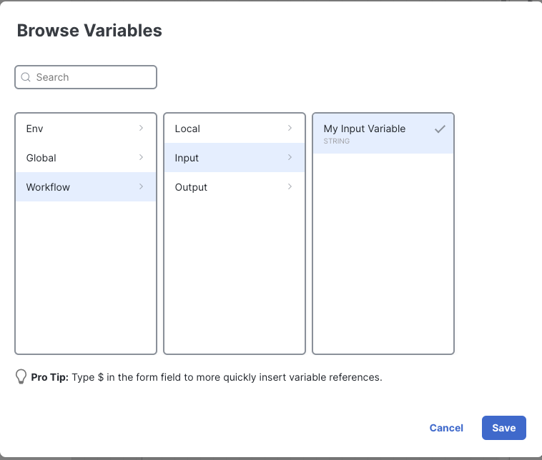
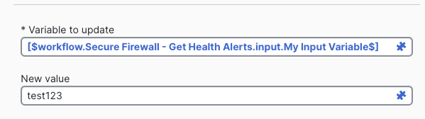
XDR Automate: Variables
Types
Scopes
Creation
Boolean
Date Time
Decimal
Integer
Secure String
String
Table
Custom Types
Global
Environment
Workflow
Local
Input
Output
Static
Usage
Notes:
If you are familiar with variables in scripting or software development, then variables in XDR Automate should be pretty familiar. They come in different types such as Boolean, String, Integer, or Datetime, and can be scoped globally (which applies to all your workflows) or within a workflow. Variables within the workflow are all defined outside of activities as shown in the screenshot and then referenced within an activity in a special format that is created through the variable browser displayed in the bottom right.

Slide 16
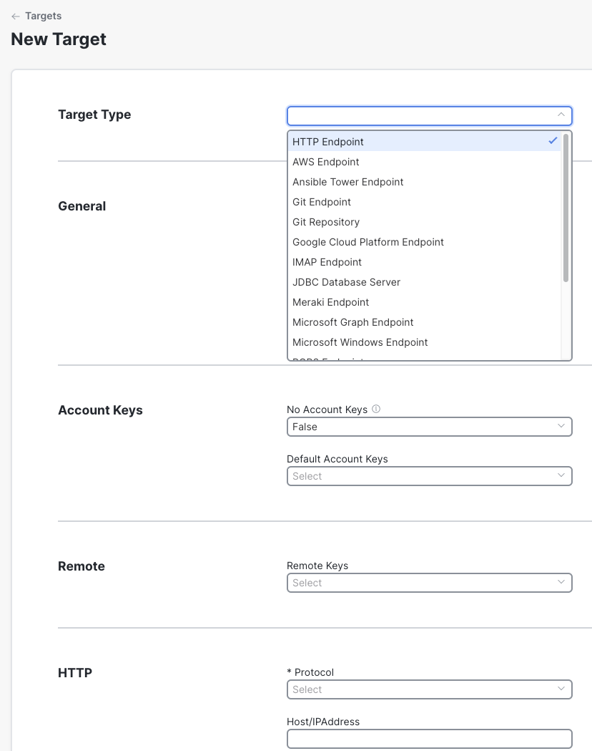
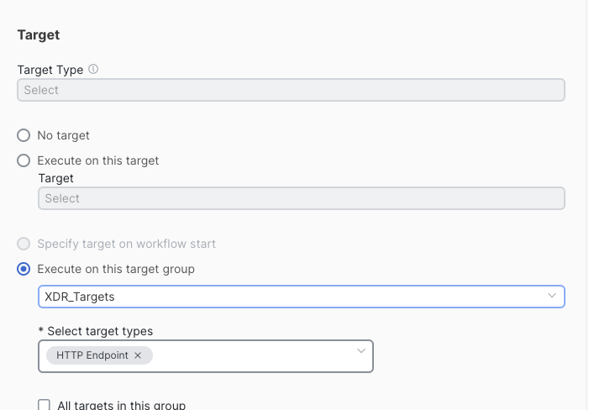
XDR Automate: Targets
Creation
Targets are the endpoints that are assigned to an activity in the workflow so the activity can “target” the communication.
Targets come in many types including HTTP, AWS, Meraki, Unix/Linux, etc.
Targets can have an account key associated, but not required.
Target groups can be configured to provide a collection of targets to a workflow.
Usage
Notes:
Targets are essentially what you what your activities are going to communicate with. Targets come in different types such as HTTP, AWS, Unix, etc. The target types change the available configuration fields. Credentials to targets are created in account keys then associated with the target. If you need to execute activities against a bulk set of targets, of the same or differing types, you can utilize target groups.

Slide 17
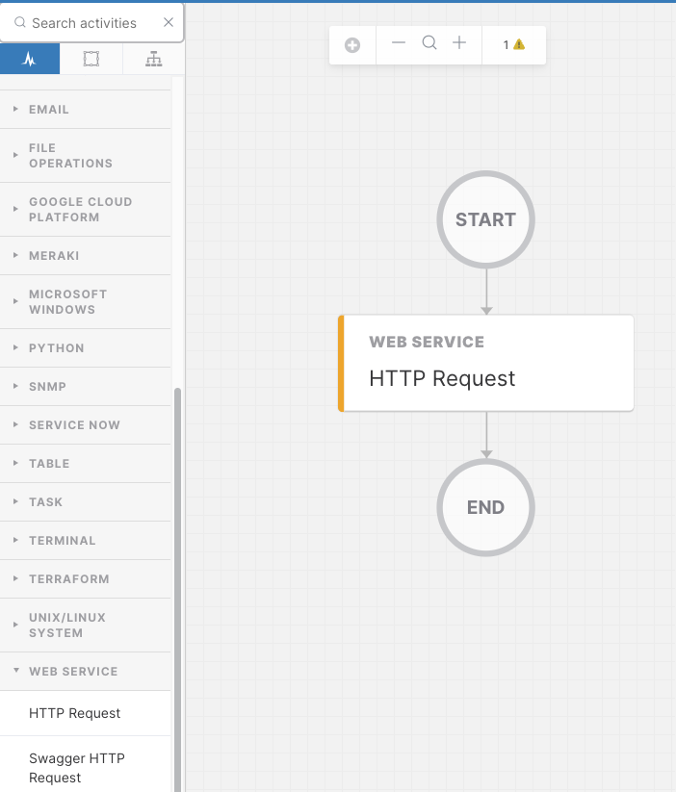
XDR Automate: Activities
Activities are the “Action Blocks” that handle all the steps in a workflow. Activities handle things such as HTTP Requests, JSON parsing, or conditional checks.
Usage
Core
Logic
Other Categories
Set Variable
Split String
JSONPath Query
Calculate Date
Find String
Match Regex
(more)
Condition Block
For Each
While Loop
Break
Completed
Group
Parallel Block
Continue
AWS Service
Cisco ISE
Ansible Tower
Database
Email
File Operations
Table
Unix/Linux
+ more!
Notes:
Activities are the “Action blocks” in the workflow. Using the long list of activities provided by the system, you can communicate with endpoints over HTTP or SSH, run python scripts, match strings, work with cloud providers such as AWS, or simply perform logic blocks like for loops, while loops, and condition blocks (which are similar to if statements in traditional programming languages).
As you can see in the screenshot, when you build the workflow , you will use the list of activities on the left side and then drag the activity into the center. You then configure the activity in a right-side panel that is not shown.

Slide 18
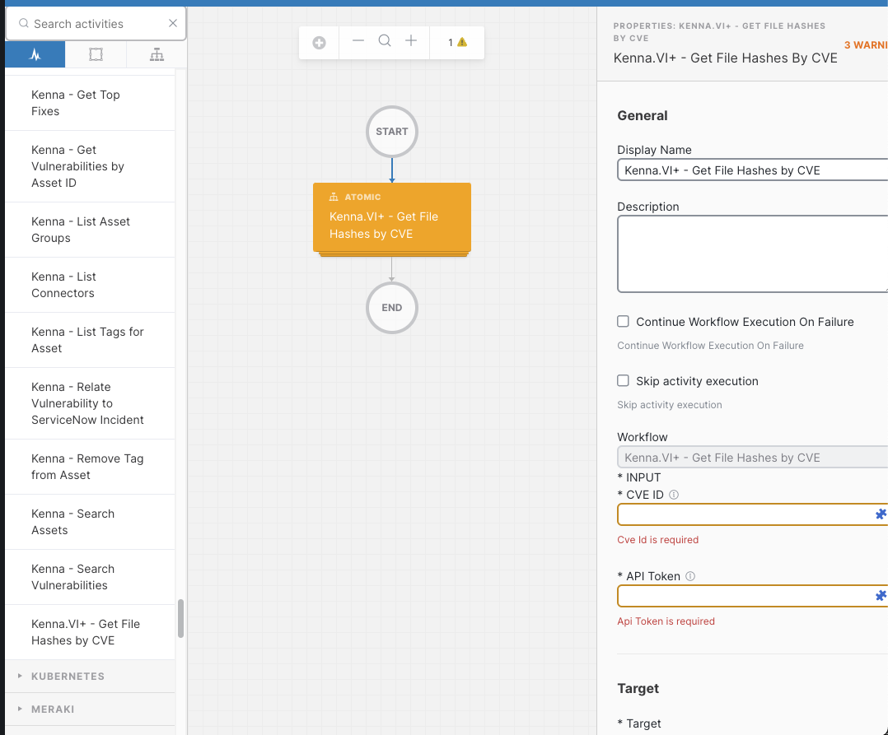
XDR Automate: Atomics
Usage
Atomic actions are self-contained workflows similar to a function in traditional programming.
XDR Automate contains many pre-built atomics, allowing you to interact with many different products such as ThreatQ, Umbrella, ServiceNow, Kenna, Meraki and more.
Atomics can be added to workflows in the same manner as activities.
You can turn your own workflows into atomics!
Notes:
Atomics are actually just workflows that are marked as Atomic . Atomics are a great way to abstract complex sets of activities to a single block similar to a function in traditional programming. Atomics will have input variables and return output variables which you can use in other activities within your workflow just like an activity. In XDR Automate, there are many pre-built atomics that allow you easily interact with other products in a single step.
You can even build your own atomics from your workflows which can be used by others.

Slide 19
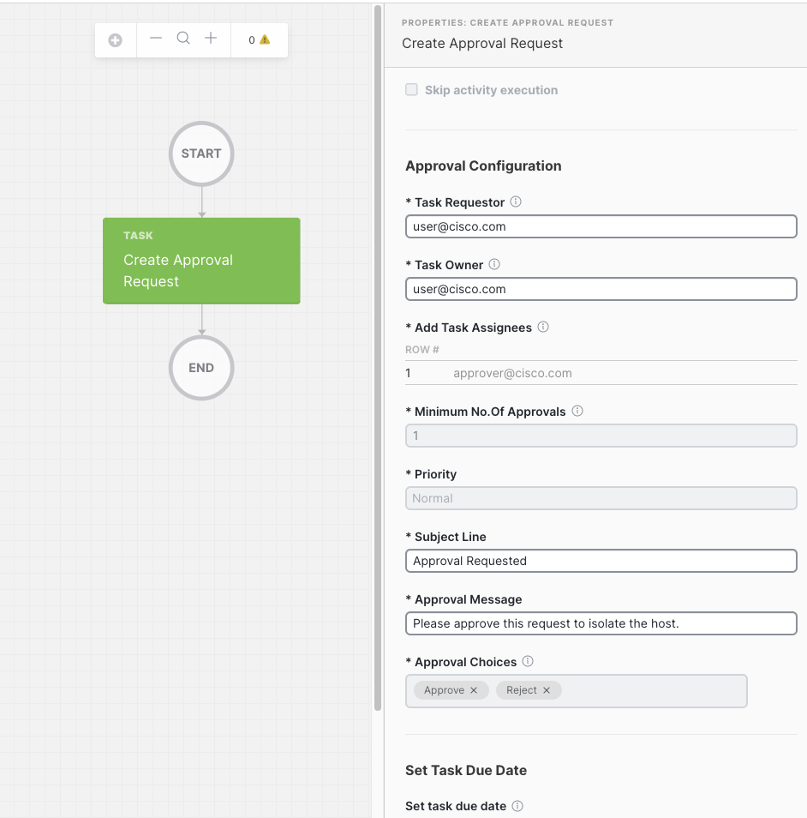
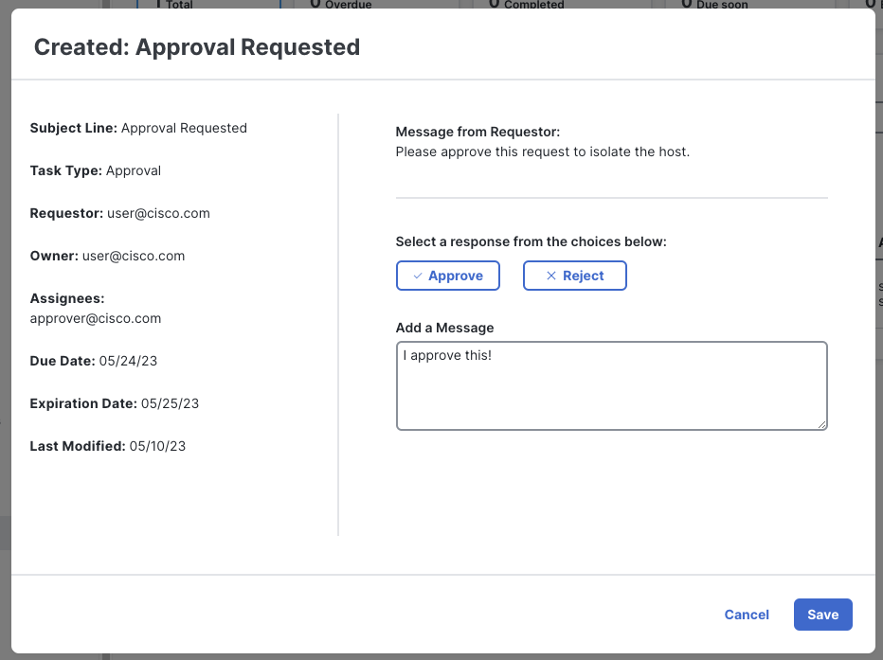
XDR Automate: Tasks
Tasks allow your workflow to pause and wait for an event (email/incident/webhook) or approval from a human.
Usage
Notes:
Tasks are a way for workflows to pause and wait for some event to occur. The most frequently used task is the Create approval task, which when executed in a workflow, pauses the workflow, creates an approval record, then waits for the designated user to login and process the request as shown on the screen. You can use approval requests do things such as approve a change or ask for more information.

Slide 20
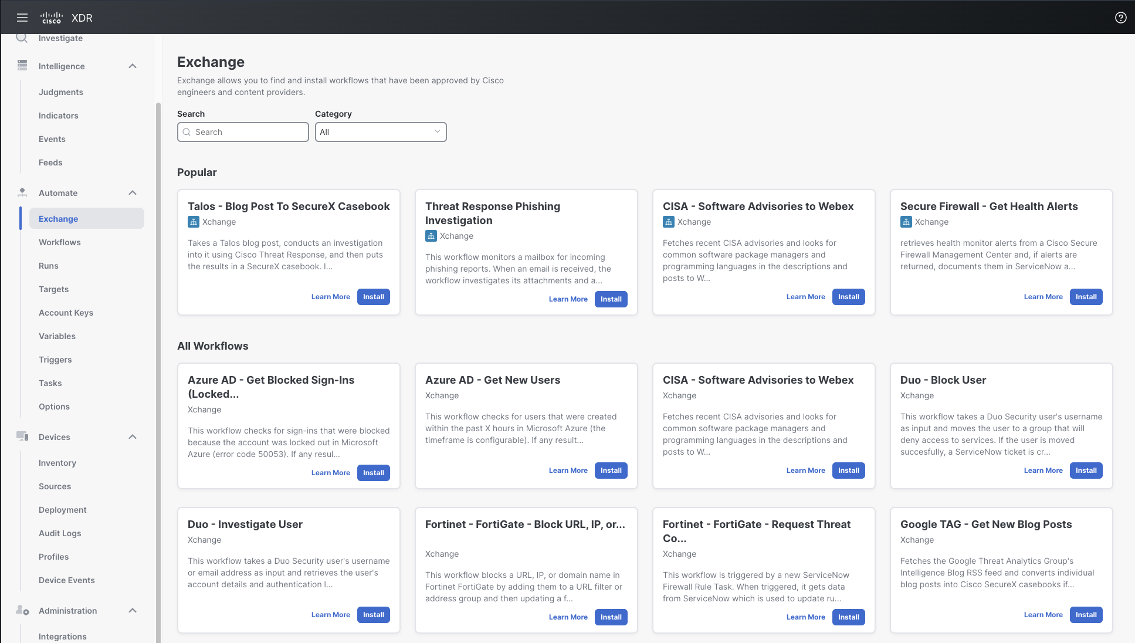
XDR Automate: Exchange
You don’t have to start building workflows from scratch!
Use the Exchange to 1-click install workflows that have been approved by Cisco.
Notes:
A section of XDR Automate that you will not want to forget about is the Exchange. The exchange allows you to install workflows that have been approved by Cisco in 1 click. You can think of this sort of like an app store, but unlike say the Apple app store, once you install, you have the freedom to change the workflows as you wish. This is a great way to add new automation to your instance or serve as a starting point for building your own complex workflows.
Now I am going to hand it over to Aman who is going to walk you through a live demo…

Slide 21
Use Case: Blocking Ransomware Command & Control Callbacks
Using Cisco XDR, Cisco Umbrella & Cisco Secure Endpoint
Notes:
Thank you, Scott!
By this point, y'all have a 100K feet overview of what Cisco XDR looks like -- and you have a 30K feet overview of what Automation with XDR Automate looks like, Scott covered some common concepts.
There are some incredible sessions happening throughout Cisco Live that go into more depth of specific parts of Cisco XDR and Scott called out a couple of them but this introductory breakout on a Monday morning in a lot of ways is meant to be a fly by overview that leaves you wanting to know more.
So in just a few moments, we're going to move away from slideware and into a live demo and you're going to see the XDR UI, and you're going to see me put together a response workflow in the UI.
.. as if covering a security topic for two Collaboration CCIEs wasn't hard enough, we decided to also do a live demo of a product that’s not GA yet, only for you lovely folks!
We're going to talk about a Command & Control use-case.

Slide 22




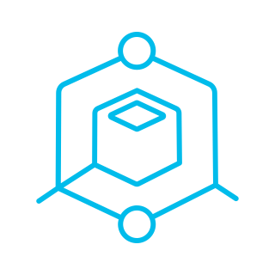
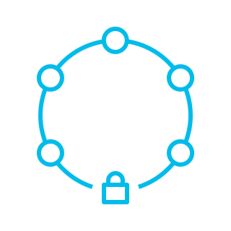
Scenario
Your organization has several remote employees who are using their personal devices to access sensitive company data.
One of the employee's laptops gets infected with ransomware that attempts to establish command & control communication before initiating data encryption.
Detection
Investigation
Automated Remediation
Validation & Monitoring
Umbrella identifies the DNS request for a malicious domain
Cisco XDR gathers the event information generated by Cisco Umbrella
Nature of threat, associated domain, details about the affected employee’s device
Cisco XDR Automate triggers an automated response workflow to remediate impact, notify teams and document actions
Continuous monitoring to ensure employee’s device is secure from future threats
Notes:
And we're going to keep this as simple as we can. We've got an employee and their laptop device has been affected with ransomware. We see requests being made to some malicious command & control or malware domains from their computer.
And we want to be able to step in very quickly and early in this process (time is key!) to first detect that this is happening, then investigate exactly what's going on, trigger an automated response workflow that takes some action to secure the organization from the threat and then continuously validate & monitor for future threats.
Cisco Umbrella is going to do the detection here,
create an incident in XDR with all of what it saw.
The creation of this incident will match what we call an “automation rule” in Cisco XDR that triggers our response workflow.
In this workflow we'll do some more investigation,
we'll use Cisco Secure Endpoint to isolate the employee's laptop,
we'll notify the employee,
we'll create a SeviceNow incident to notify our IT teams and,
document everything automation did on that incident.

Slide 23
Demo
Notes:
I’m going to go over all of this in front of you to show you how easy it is to get started and how powerful this capability is.
Of course, we’ll make some liberal assumptions along the way so this isn’t a workflow you can put into production as is – nor is this the only way or the only right way to respond to a Command & Control attack, but with the flexibility you’re about to witness, I hope you can imagine the possibilities of what you can achieve with XDR Automate.

Slide 24
Cisco Secure Managed Detection & Response (MDR) We do it for you.
Notes:
Thanks, Aman for that great demonstration of Cisco XDR Automate. Let’s take a moment to talk about our service offer, Cisco Managed Detection & Response which actually uses XDR Automate in a similar manner as what you witnessed during the demo to execute security response workflows.

Slide 25








Cisco Secure MDR
Private cloud
Public cloud
Analytics
Cisco Secure Cloud Analytics*
Aggregation / Correlation / Threat intelligence / Machine learning
Secure Endpoint
Secure Cloud Analytics*
Collector
API fetchers
Cisco Umbrella*
Customer log repository
Remote users
Secure Endpoint Cloud
DNS security
Secure web gateway
Cisco XDR Automate
Data center
On-premises
users
Automated playbooks / Enrichments / Response actions
Response Action Catalog
Umbrella
Block domains
Block URLs
Block hashes
Isolate hosts
Add custom IOCs
Security Cloud
Investigators
Researchers
Responders
Cisco integrated security architecture
Cisco security operations center experts provide monitoring and guidance
*Optional
Notes:
So why MDR? It all comes down to detecting and responding faster. As I mentioned earlier in the presentation, many organizations are struggling to keep up with the number of alerts coming into their security platforms. The longer organizations take to respond, the larger the impact, if there is a breach.
We understand that protecting your organization takes more than just technology. It takes people, time, and knowledge to fully maintain a secure environment. MDR brings our expertise, people, and infrastructure to work with your deployed Cisco security technologies. We have a world-class team of researchers, security automation experts, and SOC engineers that you can turn to for monitoring and guidance of threats coming into your environment.
Outside of adding people, we do add our own analytics platform which correlates and enriches further. Additionally, we employ consistent purpose-built orchestration and automation workflows (using XDR Automate) that allow us to continue to evolve and scale further.
The end result of MDR for your organization is detection and response measured in minutes, when the industry can average days.
Now let me take you back to Aman one last time to wrap things up.

Slide 26
Conclusion
Notes:
Thank you, Scott!
We're almost at the end but I hope you'll spend just a couple more minutes with us as we wrap up with a few key takeaways and call to action.

Slide 27
To summarize..
To address the threats of tomorrow, we need to change how we look at detection & response today
Cisco XDR simplifies security operations, speeds up investigations and accelerates response
XDR Automate is a flexible & powerful no-to-low code platform to orchestrate how your organization investigates & responds to threats
Cisco Managed Detection & Response (MDR) provides the capabilities of Cisco XDR as a managed service with packaged automated response actions
Cisco CX Automation delivers services as code to help you implement a full DevOps motion across Cisco architectures and solutions
Notes:
To summarize the last 50-odd minutes you’ve spent with us:
We looked at Cisco XDR and how everything from the UI to the core capabilities to the community is designed from the ground-up to simplify your security operations experience and accelerate your detection & response outcomes
We went an inch deeper into XDR Automate. We wrote a whole custom response workflow without a single line of code in a matter of minutes and hooked it into a detection event, so it fires automatically to respond to a threat. That is so powerful.
Now, you could work within XDR & XDR Automate yourself but if you’d like Cisco to do it for you and bring in all our intellectual capital, our expertise and a world class team of investigators, security automation experts and SOC engineers, Scott talked to you about Managed Detection & Response. We’ll tune down the noise, we’ll tell you what you need to know and what you need to do and when you need to do it. This is where you focus on outcomes and let us worry about the rest.
Oh and by the way, we bring that mindset to all Cisco architectures, not just security. Scott & I represent the CX Automation group and everything we do to create or deliver value is to help you adopt technology faster, realize outcomes quicker and scale reliably & sustainably. We can meet you where you are today and help you move further along on your automation journey.

Slide 28

Continue the Conversation with Cisco Customer Experience
Visit the Cisco Customer Experience
Booth (#3310) in the WoS for
Lightning Talks, Workshops, and Demos
1
VISIT:
2
Visit CX at Cisco Live website
Notes:
If you would like to learn more about that or talk to us about other business outcomes we can help you accomplish or accelerate, please check out our CX booth in the World of Solutions.
We are very, very, VERY big on demos. We’re an organization of creators and builders, and so we’d love to show you things in action, sit down with you and learn more about your problems, share what we’re working on and see how you feel about that, get your feedback as design partners

Slide 29








Credits
Questions?
Andy Hagar
Security Automation Leader, Cisco CX
Tuan Huynh
Engineering Leader, Cisco CX
Interact with experts on Webex: https://ciscolive.ciscoevents.com/ciscolivebot/#BRKATO-1557
Kevin Perkins
Automation Engineer, Cisco CX
Visit the CX MDR booth at Cisco Live: SEC-12
Jay Kuhne
Solutions Architect, Cisco CX
View session content on GitHub: http://cs.co/cl-xdr-automate
Russ Hardison
Sr. Director, Cisco CX
Notes:
This session wouldn’t be possible without the real security experts: Andy, Tuan & Kevin. They’re absolute rockstars, they are on the team that built MDR and work on making MDR better & more valuable for you every day. We have the honor & privilege of presenting some of their work in front of you today.
And shoutout to Jay & Russ for their help in reviewing content & providing feedback.
Like we said at the beginning of the session, please use the Webex space to ask questions if you haven’t already. You get direct access to experts like Andy, Tuan, Kevin & several others.
There’s also an MDR booth at Cisco Live if you would like to meet an expert in person.
Finally, everything we shared today and the workflows I demonstrated are available on GitHub to all of you at that link, so feel free to get them and play with them in your XDR Org if you’re signed up for the beta. If you’re not signed up and are interested, a little birdie told me there will be some pretty exciting news coming your way next week after Cisco Live as we look to open this up to more people. There’s also a ton of other great content for SecureX Orchestration & XDR Automate on our GitHub so definitely worth checking out.

Slide 30



Fill out your session surveys!
Attendees who fill out a minimum of four session surveys and the overall event survey will get Cisco Live-branded socks (while supplies last)!
Attendees will also earn 100 points in the Cisco Live Game for every survey completed.
These points help you get on the leaderboard and increase your chances of winning daily and grand prizes
Notes:
Please fill out your session surveys and let us know how we did. You can get some Cisco socks and earn some points to get more prizes. We’re still at the beginning of the event and this is a great time for you to get on the leaderboard.
[SD] – Could joke ”if you liked and found our session informative, please get that survey in… If you didn’t, no action required ☺ “

Slide 31

Continue your education
Visit the Cisco Showcase for related demos
Book your one-on-one Meet the Engineer meeting
Attend the interactive education with DevNet, Capture the Flag, and Walk-in Labs
Visit the On-Demand Library for more sessions at www.CiscoLive.com/on-demand
Notes:
And your learning doesn’t have to end here. There’s so much more you can do here in person and then after the event.
If this is your first Cisco Live and you find yourself overwhelmed and wanting to go to three sessions that were scheduled at the same time, we’ve all been there! You’ll have sessions - including this one - available online on-demand after the event for you to review & consume at your own pace.

Slide 32
Notes:
Thank you for spending Monday morning with us. I hope this was useful and you have a great week here with us.
If you have any questions for us on what we presented or otherwise, please ask away. If we can’t answer it for you, we’ll make sure we find someone with answers.

Slide 34
Why MDR?
Time to respond to threats is a critical factor
Late detection
High impact
2022 had the highest average breach cost in 18 years
Early detection
Low impact
TIME
207
Industry average detection time for a breach
70
Industry average time to contain a breach
$4.35M
Average cost of a data breach
DAYS
DAYS
Source: IBM Security and Ponemon Institute 2022 Cost of a Data Breach Study
Notes:
Slide 26
So why MDR? Let’s start to unpack that.
Take a look at this graphic which is not meant to scare you but convey how longer time to detect and respond to a breach results in a higher impact. Research from the 2022 Cost of Data Breach study showed that the average mean time to detect a breach is 207 days, add that to another 70 days to contain the breach which results in an average cost of 4.35 million dollars.
But organizations that employed XDR technologies actually reduced their time to detect by 29 days. Its clear that organizations who invest in reducing dectection and response times end up with low impact if a breach should occur.
======
Businesses are prone to a breach more than ever.
(This slide isn’t meant to be a scare tactic).
It is meant to convey some statistics that we used to analyze and determine how Cisco can meet the demands our customers are facing and to accelerate security operations.
Let’s spend a couple minutes talking about some of the statistics:
Research* states that in 2022, the average mean time to detect is 207 days, 70 days to contain, and costs $4.35 million on average per each breach. Organizations with XDR technologies identified and contained a breach 29 days faster than those without XDR *Source: IBM Security and Ponemon Institute 2022 Cost of a Data Breach Study
2022’s average cost of a data breach was the highest ever
The US had the highest global cost of a data breach at $9.44M
Healthcare was highest cost industry for the 12th year in a row. The average total cost of a breach in healthcare increased from USD 9.23 million in the 2021 report to USD 10.10 million in 2022, an increase of USD 0.87 million or 9.4%. Following healthcare were the financial, pharmaceuticals, technology and energy industries.
Minimizing the impact of a breach is largely a function of reducing the mean time to detection.

Slide 35




Why MDR?
Security operations challenges
Find, recruit, retain, and afford security expertise
Keep pace with current threats
Keep up with the growing attack surface, especially with the popularity of hybrid work models
Manage the overwhelming number of threats without defined playbooks
3.5 million cybersecurity positions are projected to go unfilled in to 2025*
*According to Cybercrime Magazine
Notes:
Slide 27
Cisco understands that your security challenges go beyond technology. Companies are struggling to find , recruit, and retain personnel. Even with the personnel, companies have to cover a growing number of threats against growing attack services without defined playbooks.
While these factors are not new, they contribute to a higher security risk
=========
We understand that your security challenges run deeper than technology.
These challenges although not new, continue to plague operations teams and when paired with rapid change and requirements to respond to new business and operational demands.
What companies are sharing with us is that they are struggling to:
Find, recruit, retain, and afford security expertise (senior researchers and responders)
Keep pace with current threats;
Keep up with the growing attack surface, and;
Manage an overwhelming number of alerts and events, and establish strong automations through defined playbooks
These factors contribute to gaps in security, higher operational costs, and a less efficient team that contribute to increased security risk.

Slide 36


Cisco can help!
Focus visibility across your entire attack surface, spanning cloud, network, and endpoints
Advance security operations through integrated threat intelligence to prioritize threats
Accelerate detection to ensure consistent and disciplined response actions
Notes:
Slide 8
Cisco MDR can help by focusing visibility across cloud, network and endpoints.
Cisco MDR can advance security operations through integrated threat intelligence to priorities threats.
And most of all Cisco MDR can accelerate detection to ensure consistent and disciplined response actions.
====
Cisco Secure MDR can help… by:
Focusing visibility across the entire attack surface to monitor for malicious behavior across the cloud, network and endpoints;
Advancing security operations through integrated threat intelligence to prioritize threats; and
Accelerating detection to ensure consistent and disciplined response actions.

Slide 37
Reduce mean time to detect and respond to a threat from months to minutes
Before Cisco Secure MDR
Inefficient, error-prone process, requiring manual threat correlation, and performing complex tasks across multiple systems which can result in missed threats and delayed responses
1
Alert triggered
2
Investigation in multiple consoles
3
Response/remediation in multiple consoles
Product dashboard 1
Product dashboard 2
Product dashboard 3
Product dashboard 4
Product dashboard 1
Product dashboard 2
Product dashboard 3
Product dashboard 4
Industry average: time to detect a threat: 207 days*
Industry average: time to respond to a threat: 70 days*
With Cisco Secure MDR
Accelerated detection and response to security threats provided by an integrated security ecosystem, unique threat intelligence, proven case management, defined playbooks, and response recommendations by an elite team of security experts
Cisco-led actions
Cisco and customer actions
Alert triggered
Analysis
Investigation
4
Response actions
1
2
3
MDR time to detect = 5 minutes**
MDR time to acknowledge/respond = 15-30 minutes**
*IBM Security and Ponemon Institute 2022 Cost of a Data Breach Study **Typical metrics taken from MDR Customer Portal
Notes:
Slide 29
Customers who come to Cisco MDR are frustrated, they are looking at multiple product dashboards to do their investigation, multiple dashboards or tools to do the remediation and they don’t have enough people. Looking at industry averages, this is not uncommon as the time to detect threats is hundreds of days.
Our internal metrics for Cisco MDR show we detect issues within 5 minutes and respond in less than 30 minutes. We are able to do this by having an integrated solution and proven defined playbooks created by our security experts.
-----------------------------
From Evan:
You will catch comments on these metrics, which will relate to dwell time.
The reason for the difference in average is that the detect and respond times are largely from unmonitored sections of an organization.
Have a talk track ready to speak to the scope limitation that’s in every service versus an entire organization and how to cover gaps.
Before Secure MDR: Inefficient, error-prone process, requiring manual threat correlation, and performing complex tasks across multiple systems which can result in missed threats and delayed responses. With Secure MDR: Accelerated detection and response to security threats provided by an integrated security ecosystem, unique threat intelligence, proven case management, defined playbooks and response recommendations by an elite team of security experts.
Source: IBM Security and Ponemon Institute 2022 Cost of a Data Breach Study: https://www.ibm.com/reports/data-breach

Slide 38






Cisco Secure MDR
Event Flow
Customer Security Architecture
Cisco Umbrella®*
Cisco Secure Endpoint
Cisco Secure Malware Analytics
Cisco Secure Cloud Analytics*
Aggregation/ Correlation/Threat Intelligence/Machine Learning
Analytics
Collector
API Fetchers
Customer Log Repository
Cisco XDR Automate
Automated Playbooks/Enrichments/Response Actions
Customer
Cisco SOC
*Optional
Notes:
Slide 30
Take a look at the event flow with Cisco MDR. It all starts with our four core Cisco security technologies: Cisco Secure Endpoint, Cisco Secure Malware Analytics, Umbrella (optional), and Cisco Secure Cloud Analytics (optional) . From there, we combine CX cloud-based analytics and correlation capabilities with the Cisco XDR to run enrichments and playbooks.
From there, we have our Cisco MDR SOC analyze the incident. If the team determines that the incident is a breach, they will quickly engage Cisco Incident Response. Note that I don’t want to just skip over our biggest asset here; our people. We have an expert team of investigators and responders. We have such a quality team of people because Cisco is ranked as one of the best places to work globally so we can recruit and maintain top talent.
Jumping back to our event flow; once the SOC has analyzed the incident that it will be pushed to ServiceNow. ServiceNow is our interaction point with the customer so that not only can we keep the customer informed but we can align to their processes in approvals of remediation actions.
Now let me hand it back one more time to Aman to wrap things up…
=====
Someone is going to ask; can I get the MDR workflows from you to use in XDR?
---
Secure MDR collects telemetry from Cisco security products installed in your network, and subjects it to scrutiny (analysis and investigations) from expert researchers, investigators, and responders located in Cisco global security operations centers, using automated intelligence, and research from Cisco Talos Intelligence Group. If a real threat is identified, you are alerted in near-real time, and we work with you to contain and respond.
Secure MRD leverages Cisco’s world-class integrated cloud security architecture that can provide visibility across cloud, network and endpoints to advance security operations capabilities. Delivered 24x7x365, the service provides threat detection and response to reduce mean time to detect and contain threats faster with relevant, meaningful and prioritized response actions.
The Cisco Secure MDR offer combines an elite team of researchers, investigators and responders with Cisco’s MDR threat intelligence, automation and response capabilities, and defined investigations and response playbooks supported by Cisco Talos threat research.
Expert team of researchers, investigators and responders
Our employees are one of our biggest assets. Cisco attracts and retains top talent and is consistently ranked one of best companies to work for, globally.
Threat Intelligence and Automation
We built and host a cloud-based, world-class analytics and automation capability so you don’t have to.
Defined Investigations and Response Playbooks
Our expert analysts utilize proven security operations case management and security orchestration and automation response (SOAR) to contain, mitigate and eradicate threats using response action playbooks and action plans aligned with your company’s security operations policy.
Cisco Integrated Security Architecture
MDR leverages Cisco’s world-class integrated cloud security architecture - consisting of Cisco Secure Cloud Analytics, Cisco Secure Endpoint, Cisco Secure Malware Analytics, and Umbrella. MDR requires Cisco Secure Endpoint and Cisco Secure Malware Analytics be installed and licensed. Cisco Umbrella and Cisco Secure Cloud Analytics are optional.
Using these technologies, the MDR increases visibility and applies context across the attack surface
It detects threats on premises and across multi-cloud environments
And responds to threats with automated responses
Customer Portal
The MDR Customer Portal is the one-stop for all service interactions. It includes a dashboard, ticketing, reporting and case management that provides both operations and executive visibility to all activities.
The Service Dashboard provides an interactive snapshot of activities and metrics in one place where you can see the effectiveness of MDR to securing your business.
Talos Incident Response
When an alert becomes a breach, the MDR team coordinates with Cisco’s Incident Response Service for forensic investigations which provides next-level capabilities.
[This is how an event flows through the MDR Threat Intelligence platform.]
We've already seen at a high level how the Cisco security technologies cover the attack surface across cloud, network, and endpoints
It is the data from our four core Cisco security technologies – Cisco Secure Endpoint, Cisco Secure Malware Analytics, Umbrella (optional), and Cisco Secure Cloud Analytics (optional) – that feed into our use cases.
This takes place when that data is collected by the Analytics Platform.
Identified events are sent to the SOAR Platform where enrichments and playbooks are run and is the main interaction point for the MDR SOC.
Once the SOAR and the SOC has analyzed an event, it is sent to ServiceNow, our ticketing platform, which is the main interaction point with the customer/partner.
Here, the customer can perform actions like approving and starting response actions, which are acted on by our four core technologies.
Transition:
Now that we know how the data flows through the Secure MDR platform, let’s look at how an event is captured by the Cisco Security Technologies.

Slide 39
Cisco CX Automation Services Accelerate execution, minimize risk and reduce operational cost

Slide 40
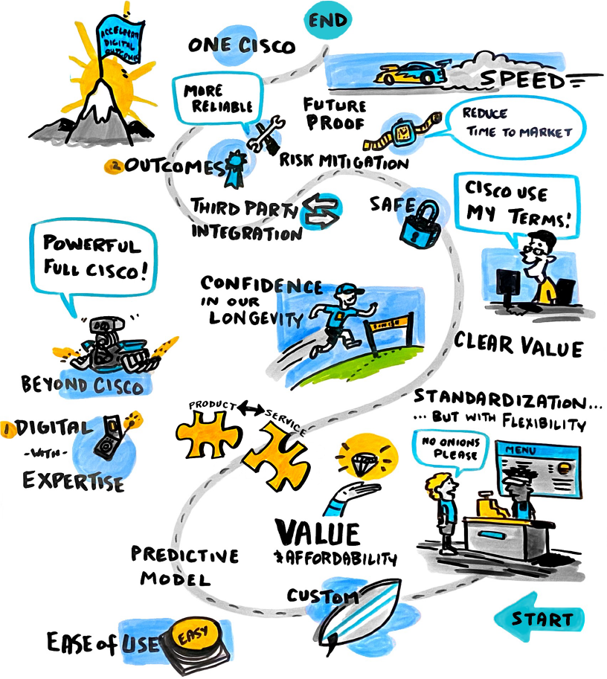

CX Automation Strategy
Our customers expect Services as Software to simplify the technology lifecycle, thereby fulfilling technology promises cross-domain and cross-vendor to realize outcomes.

Slide 41
What customers are seeking
Current focus
IT Operational
Outcomes
Business Operational Outcomes
Strategic Business Outcomes
Defining characteristics
IT use case driven
Business use case driven
IT cost reduction, IT risk reduction,
IT value
Operational efficiency, business risk reduction, business value of IT
Revenue growth,
business transformation
Value driver
Change in IT capabilities
Reduced # of security breaches
% time saved in NW troubleshooting
Change in business capabilities
% of time saved in ordering process
% increase in employee satisfaction
Change in achieving business goals
$ topline growth
% increase in new businesses mix
Success measures
(illustrative)
Sources: (detailed sources in notes) Gartner Research, Industry Analyst Interviews, IDC Research
Notes:
Gartner
Use Digital-Outcome-Driven Metrics to Quantify the Business Value of Technology Investments, Aug 2021
Develop Metrics for Business and Technology Outcomes Using a Diagnostic Approach, Jan 2022
How Much Will Business Buyers Invest in Data and Consulting Services?, April 2021
Survey Analysis: Industry Line-of-Business Buyers, April 2021
ADD Digital Business Services definition
Industry Analyst Interviews
Chrissy Healey: Digital Business outcomes
Rene Buest: Outcome oriented managed services
IDC:
Digital transformation taxonomy

Slide 42
CX Automation Blueprint
Common Automation Framework
Apps
Unified Catalog
Libraries
Customer
Outcomes
CX Offers
DevOps Method
(Services as Code)
Tools
Use Cases
Orchestration
(Digital Bus Process)
Unified Platform
Scripts
Ideas
Data Models
Governance
Legend:
What
How

Slide 43
Outcome-based mapping
Business Outcome | Use Cases | Offers
Digital transformation | Deliver best practices in the form of deployable code Accelerate adoption of new architectures and capabilities | Infrastructure as Code for ACI Migration Services (Enterprise)
Enable business capabilities through new technology | Validate design to increase confidence Validate custom design to increase confidence Accelerate DevSecOps practice and integrations | AS-T Solution Template SVS for SD-WAN (Pre-defined) SVS Custom AS-T Solution Template DevSecOps Scrum Services
Demonstrate compliance | Maintain trusted networks with software and configuration compliance verification and remediation | Compliance & Remediation
Grow revenues | Automating core processes and tasks on controller-based architectures Expand capacity, deploy and adopt new capabilities to grow revenue and business | Business Process Automation (BPA) Migration Services (SP)
Cost reduction | Self-healing networks by automating incident management lifecycle | Automated Incident and Assurance
Improve end-user experience | Unlock visibility to cross-domain insights from network controller-based telemetry Pre-empt service impacting problems | Network Wide Visibility Managed Insights
Improve customer experiences | Accelerate adoption of changes in production with automated governance, implementation and validation | Automated Change and Assurance
Optimize productivity | Automate detection of network critical events | Automated Fault Management Packaged Scrum
Enhance security | Automate threat detection & response to security events | Cisco Secure Managed Detection & Response
Reduce risk | Ongoing and on-premise testing of solution designs Increase confidence on network design with solution validation suite Combine the digital version of network with solution validation suite to expedite validation tests | Cisco Solution Validation Services Cisco Continuous Automation and Integration Testing (CAIT) Lab as a Service

Slide 44
CX Automation: Ecosystem of Solutions
Learn more at Cisco Live!
End-to-end automation across IT technologies
Example Use-Cases: Network Device Onboarding, Software Conformance
CL Presence: BRKATO-2102, PSOCX-2001, CX Automation World of Solutions Booth
Business Process Automation
Multi-vendor Network Insights & Analytics Platform
Example Use-Cases: Network Wide Visibility, Campus Network Experience, Optical Network Insights
CL Presence: BRKATO-2102, CX Automation World of Solutions Booth
Matrix
DevSecOps Validation Framework
Example Use-Cases: Compliance & Remediation, Continuous Integration, Deployment & Testing
CL Presence: BRKATO-2102, CX Automation World of Solutions Booth
CX Test Manager (CXTM)

